Slide 1
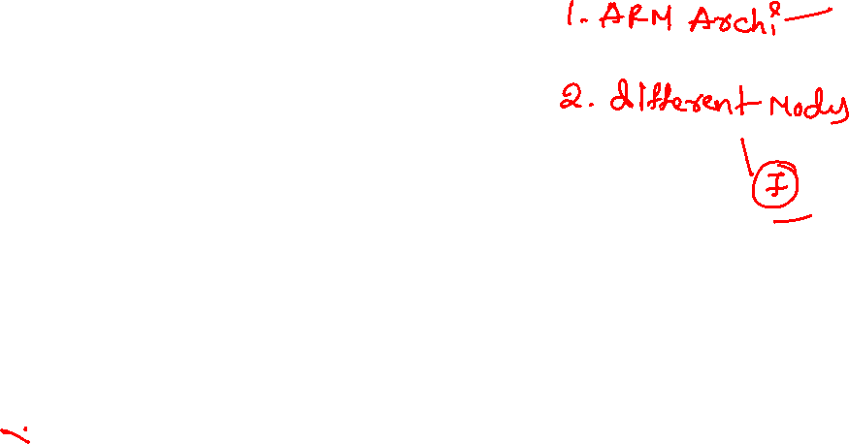
QUIZ on ARM Architecture

Slide 2

Quiz
ARM stands for _____________
a) Advanced Rate Machines
b) Advanced RISC Machines
c) Artificial Running Machines
d) Aviary Running Machines
B

Slide 3

quiz
The main importance of ARM micro-processors is providing operation with ______
a) Low cost and low power consumption
b) Higher degree of multi-tasking
c) Lower error or glitches
d) Efficient memory management
A

Slide 4

quiz
ARM processors where basically designed for _______
a) Main frame systems
b) Distributed systems
c) Mobile systems
d) Super computers
C

Slide 5

quiz
The address space in ARM is ___________
a) 2^24
b) 2^64
c) 2^16
d) 2^32
D

Slide 6
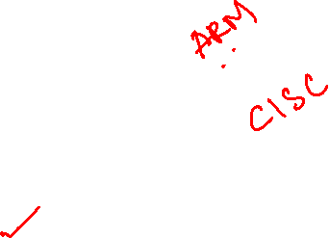
quiz
RISC stands for _________
a) Restricted Instruction Sequencing Computer
b) Restricted Instruction Sequential Compiler
c) Reduced Instruction Set Computer
d) Reduced Induction Set Computer
C

Slide 7

quiz
In the ARM, PC is implemented using ___________
a) Caches
b) Heaps
c) General purpose register
d) Stack
C

